Slide 1

Chapter 5
Analog
Transmission
5.<number>

Slide 2
Chapter 5 Outline
5.1 DIGITAL-TO-ANALOG CONVERSION
5.2 ANALOG-TO-ANALOG CONVERSION

Slide 3
Chapter 5 Objective
The first section discusses digital-to-analog conversion. The section shows how we can change digital data to an analog signal when a band-pass channel is available. The first method described is called amplitude shift keying (ASK), in which the amplitude of a carrier is changed using the digital data. The second method described is called frequency shift keying (FSK), in which the frequency of a carrier is changed using the digital data. The third method described is called phase shift keying (PSK), in which the phase of a carrier signal is changed to represent digital data. The fourth method described is called quadrature amplitude modulation (QAM), in which both amplitude and phase of a carrier signal are changed to represent digital data.

Slide 4
Chapter 5 Outline
The second section discusses analog-to-analog conversion. The section shows how we can change an analog signal to a new analog signal with a smaller bandwidth. The conversion is used when only a band-pass channel is available. The first method is called amplitude modulation (AM), in which the amplitude of a carrier is changed based on the changes in the original analog signal. The second method is called frequency modulation (FM), in which the phase of a carrier is changed based on the changes in the original analog signal. The third method is called phase modulation (PM), in which the phase of a carrier signal is changed to show the changes in the original signal.

Slide 5
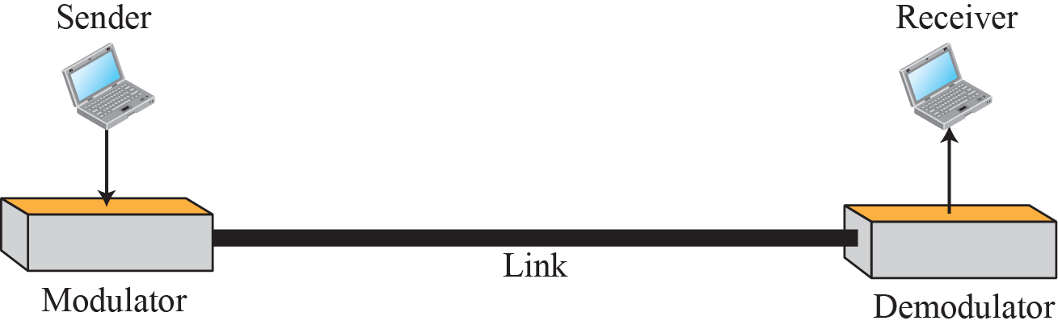
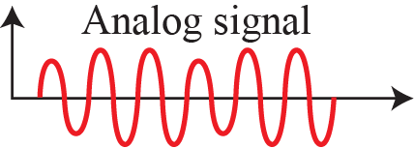
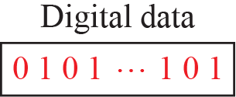
5.1 Digital-to-Analog Conversion
Digital-to-Analog Conversion
  The digital data is converted to analog signal by the digital-to-analog modulating process.
Topics discussed in this section:
5.1.1 Aspects of Digital-to-Analog Conversion
5.1.2 Amplitude Shift Keying
5.1.3 Frequency Shift Keying
5.1.4 Phase Shift Keying
5.1.5 Quadrature Amplitude Modulation

Slide 6

5.1 Digital-to-Analog Conversion
Types of digital to analog conversion
  The most fundamental digital modulation techniques are based on keying (shift keying).

Slide 7


5.1.1 Aspects of Conversion
Data Rate Versus Signal Rate
  S = N × baud
    N is the data rate(bps).
    r is the number of data elements carried in one signal element.
    L is the number of signal element.
Bit rate is the number of bits per second.
Baud rate is the number of signal elements per second.
In the analog transmission of digital data, the baud rate is less than or equal to the bit rate.

Slide 8
Example 5.1
Bit Rate ?
  An analog signal carries 4 bits per signal element.
  If 1000 signal elements are sent per second, find the bit rate.
Solution
  In this case, r = 4, S = 1000, and N is unknown.
  We can find the value of N from

Slide 9
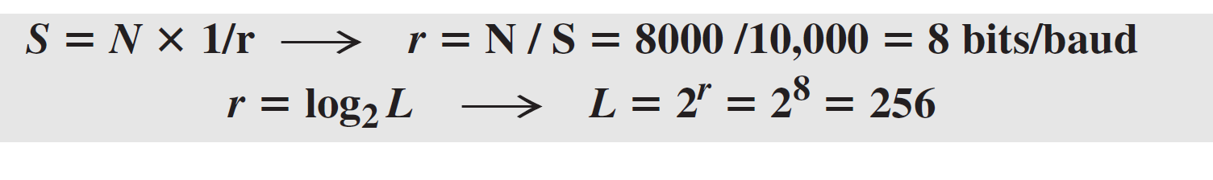
Example 5.2
Data Elements & Signal Elements
  An analog signal has a bit rate of 8000 bps and a baud rate of 1000 baud.
  How many data elements are carried by each signal element?
  How many signal elements do we need?
Solution
  In this example, S = 1000, N = 8000, and r and L are unknown.
  We first find the value of r and then the value of L.
1000

Slide 10
5.1.1 Aspects of Conversion
Carrier Signal (반송파)
  The sending device produces a high frequency signal that acts as a base signal.
  The base signal is called the carrier signal or carrier frequency.
  Digital information changes the carrier signal by modifying one or more its characteristic (amplitude, frequency, phase).
Modulation(or Shift Keying)
  One or more characteristics of the carrier signal is varied to create signal elements.
  Amplitude Shift Keying, Frequency Shift Keying, Phase Shift Keying

Slide 11
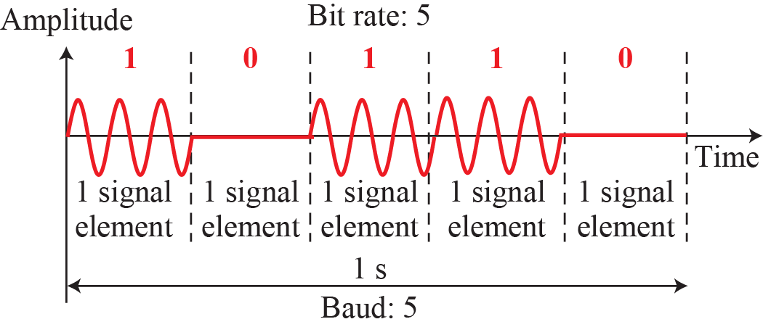
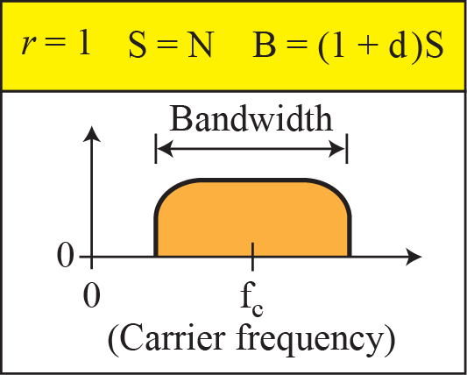
5.1.2 Amplitude Shift Keying (ASK)
ASK(Amplitude Shift Keying)
  The amplitude of the carrier signal is varied to create signal elements.
  Both frequency and phase remain constant while the amplitude changes.

Slide 12

5.1.2 ASK (Amplitude Shift Keying)
Implementation of binary ASK

Slide 13
Example 5.3
Bit Rate of ASK?
  We have an available bandwidth of 100 kHz which spans from 200 to 300 kHz.
  We modulated our data by using ASK with d = 1.
  What are the carrier frequency and the bit rate ?
Solution
  The middle of the bandwidth is located at 250 kHz.
  This means that our carrier frequency can be at fc = 250 kHz.
  We can use the formula for bandwidth to find the bit rate (with d = 1 and r = 1).

Slide 14

Example 5.4
Bandwidth of a full-duplex ASK
  We use full-duplex links for data communications.
  We need to divide the bandwidth into two carrier frequencies for full-duplex links.
  If the available bandwidth for each direction is 50 kHz, which leaves us with a data rate of 25 kbps in each direction.

Slide 15
5.1.2 ASK (Amplitude Shift Keying)
Multilevel ASK
  It uses more than two amplitudes, such as 4, 8, 16, or more different amplitudes for the signal.
  The signals modulate the data using 2, 3,4, or more bit at a time. ( r = 2, 3, 4, and so on )
  Not implemented with pure ASK, but implemented with QAM.

Slide 16
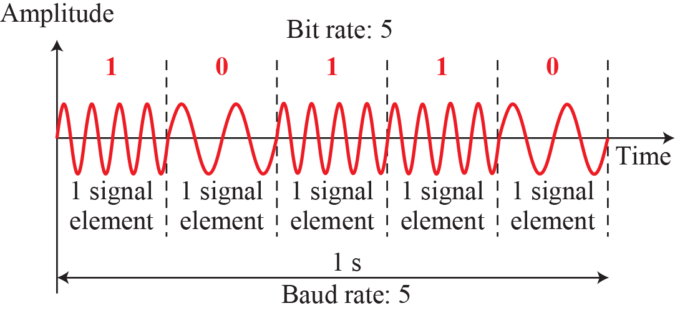
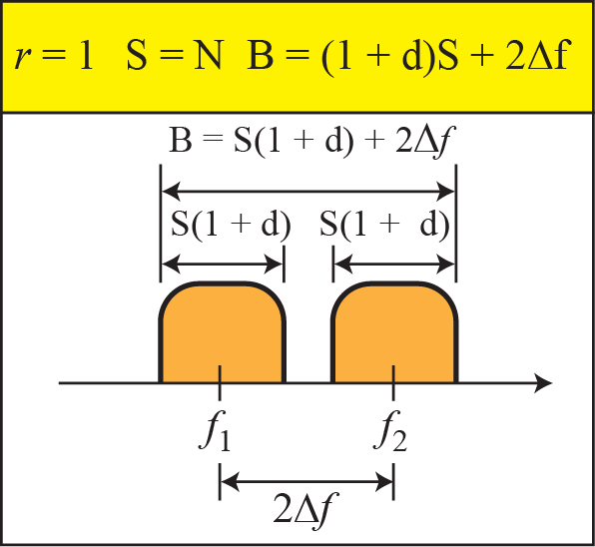
5.1.3 Frequency Shift Keying (FSK)
FSK(Frequency Shift Keying)
  The frequency of the carrier signal is varied to represent data.
Binary FSK
f₂
f₁

Slide 17

5.1.3 FSK(Frequency Shift Keying)
Implementation of BFSK
Required Bandwidth of FSK :
B = (1 + d) × S + 2Δ_{f}
B: Bandwidth, d: 0~1, S: signal rate
2Δ_{f} : The difference between the two frequency, f1 and f2

Slide 18
Example 5.5
Bit Rate?
  We have an available bandwidth of 100 kHz which spans from 200 to 300 kHz.
  We modulated our data by using FSK with d = 1?
  What should be the carrier frequency and the bit rate?
Solution
  we are modulating by using FSK.
  The midpoint of the band is at 250 kHz.
  We choose 2Δf to be 50 kHz; this means

Slide 19
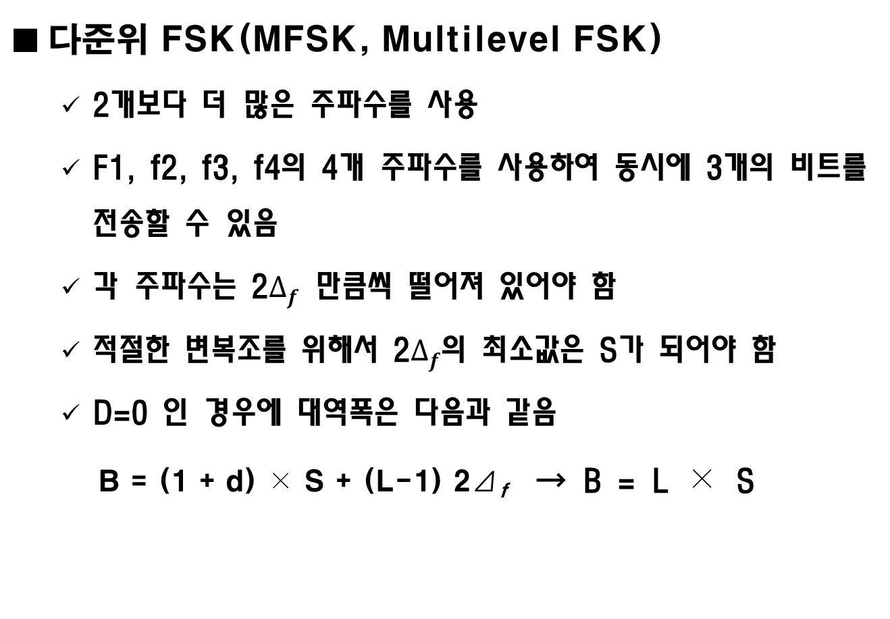
5.1.3 FSK(Frequency Shift Keying)
2

Slide 20

Example 5.6
Bandwidth of MFSK?
  We need to send data 3 bits at a time at a bit rate of 3Mbps.
  The carrier frequency is 10MHz.
  Calculate the number of levels (different frequencies), the baud rate, and the bandwidth.
6
7
8
9
11
12
13
14
Solution
We can have signal level L = 2³ = 8.
The baud rate is S = 3MHz/3 = 1 Mbaud.
This means the carrier frequencies must be 1MHz apart (2Δf = 1 MHz).
The bandwidth is B = 8 × 1MHz = 8MHz.

Slide 21
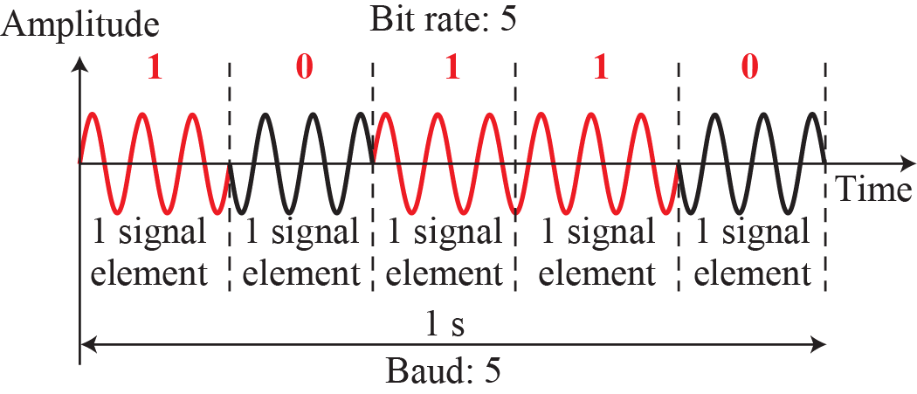
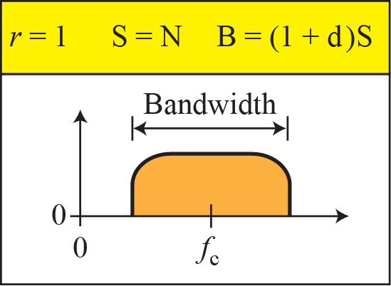
5.1.4 PSK(Phase Shift Keying)
PSK
  The phase of the carrier is varied to represent two or more different signal elements.
  Today, PSK is more common than ASK or FSK.
Binary PSK(BPSK)
  It uses two phases which are separated by 180°.

Slide 22

5.1.4 Phase Shift Keying (PSK)
Binary PSK
  Most robust to noise and easy to implement
  Bandwidth : B = (1 + d) × S
Implementation of Binary PSK
0⁰
180⁰
0⁰
0⁰
180⁰

Slide 23
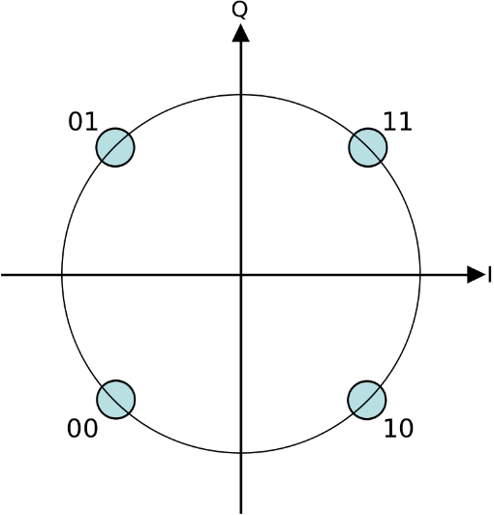
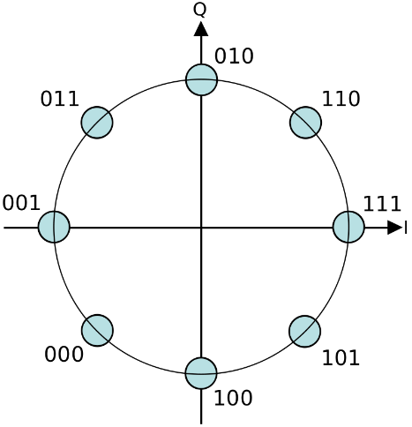
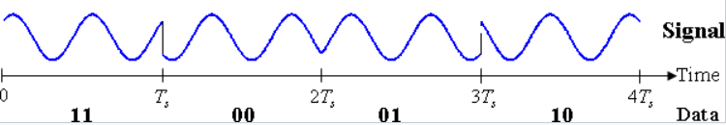
5.1.4 PSK(Phase Shift Keying)
Quadrature PSK(QPSK)
  QPSK uses four points on the constellation diagram.
  (45⁰, -45⁰, 135⁰, -135⁰) : two bits per symbol.
  The error-rate becomes too high in more than 8 phases.
Constellation diagram for 4-PSK and 8-PSK
10
01

Slide 24

5.1.4 PSK(Phase Shift Keying)
Conceptual transmitter structure for QPSK
  The binary data stream is split into two components. These are then separately modulated.
  The two signals are superimposed, and the resulting signal is the QPSK signal.

Slide 25
Example 5.7
Bandwidth for QPSK?
  Find the bandwidth for a signal transmitting at 12 Mbps for QPSK. The value of d = 0.
Solution
  For QPSK, 2 bits are carried by one signal element.
  This means that r = 2.
  So the signal rate (baud rate) is S = N × (1/r) = 6 Mbaud.
  With a value of d = 0, we have B = S = 6 MHz.

Slide 26
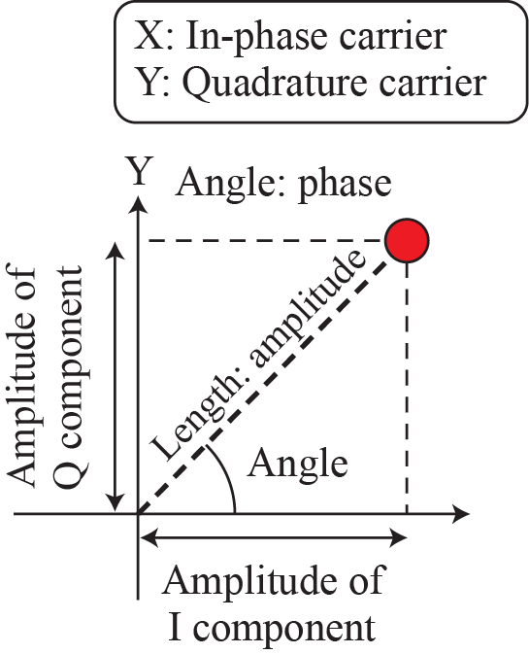
5.1.4 PSK(Phase Shift Keying)
Constellation Diagram
  A representation of a signal modulating a digital data such as quadrature amplitude modulation (QAM) or phase-shift keying.
  The distance of a point : he amplitude or power of the signal.
  The angle of a point : the phase shift of the carrier wave. (counterclockwise)

Slide 27
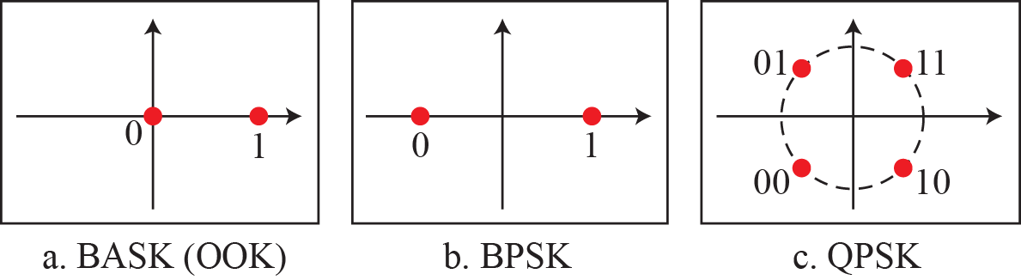
Example 5.8
Show the constellation diagrams for ASK (OOK), BPSK, and QPSK signals.
(OOK, ON-OFF keying)
Solution
three constellation diagrams.

Slide 28
5.1.5 QAM(Quadrature Amplitude Modulation)
Quadrature Amplitude Modulation(QAM)
  QAM, which combines ASK and PSK, is the dominant method of digital-to-analog modulation.
Quadrature amplitude modulation is a combination of ASK and PSK.

Slide 29
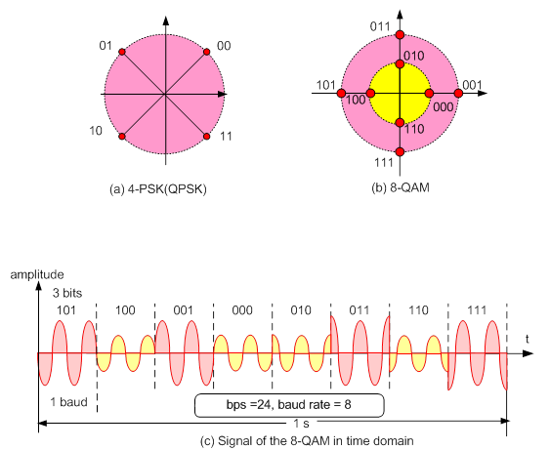
5.1.5 QAM(Quadrature Amplitude Modulation)
Example of QAM

Slide 30
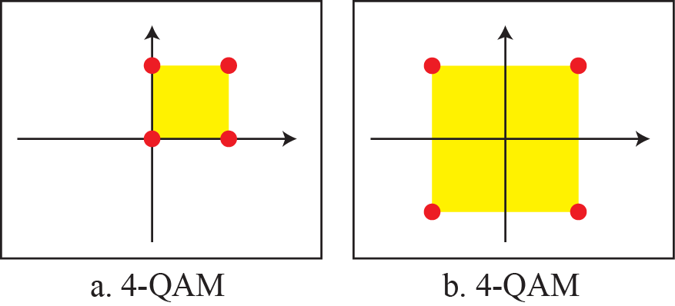
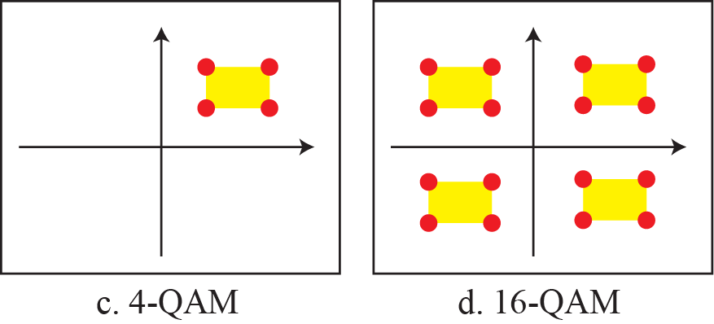
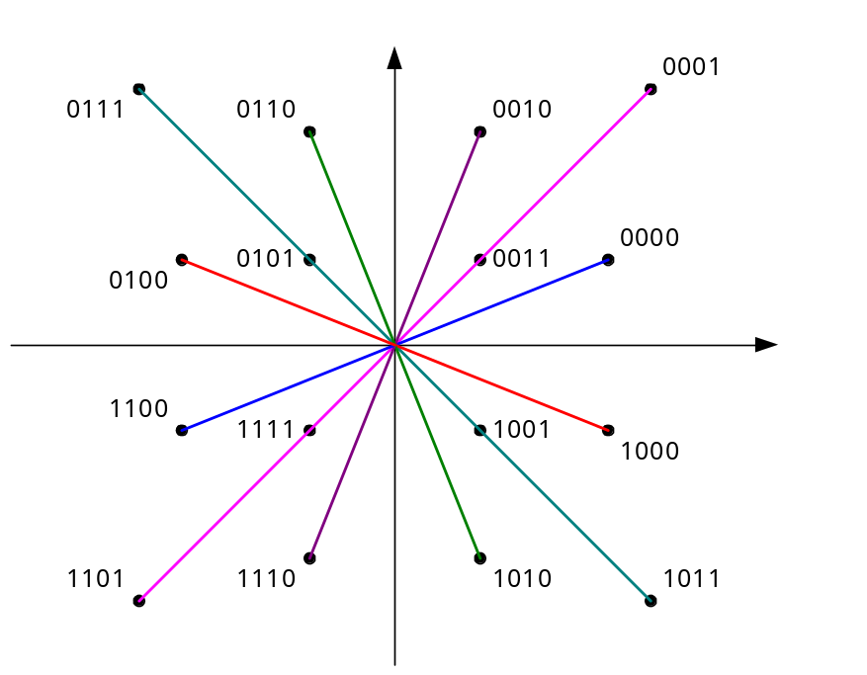
5.1.5 QAM(Quadrature Amplitude Modulation)
Example of QAM
9600bps 16-QAM

Slide 31
5.1.5 QAM(Quadrature Amplitude Modulation)
Application of QAM
  Modulation can send the signal further.
  Digital TV Broadcasting for Satellite : QPSK Modulation
  Digital TV Broadcasting for CATV : QAM Modulation

Slide 32
5.2 Analog-to-Analog Conversion
Analog-to-analog conversion, or analog modulation, is the representation of analog information by an analog signal.
The modulation of original analog signal is needed if the medium is bandpass in nature or if only a bandpass channel is available to us.
Topics discussed in this section:
5.2.1 Amplitude Modulation
5.2.2 Frequency Modulation
5.2.3 Phase Modulation

Slide 33
5.2.1 Aspects of Conversion
Carrier Signal(Carrier Frequency) - 반송파
  It is a modulated (modified) waveform of an input signal for the purpose of conveying information.
  Carrier wave usually has a much higher frequency than the input signal does.
Modulation
  It is the process of varying one or more properties of a periodic waveform, called the carrier signal.

Slide 34

5.2 Analog-to-Analog Conversion
Type of analog-to-analog conversion

Slide 35
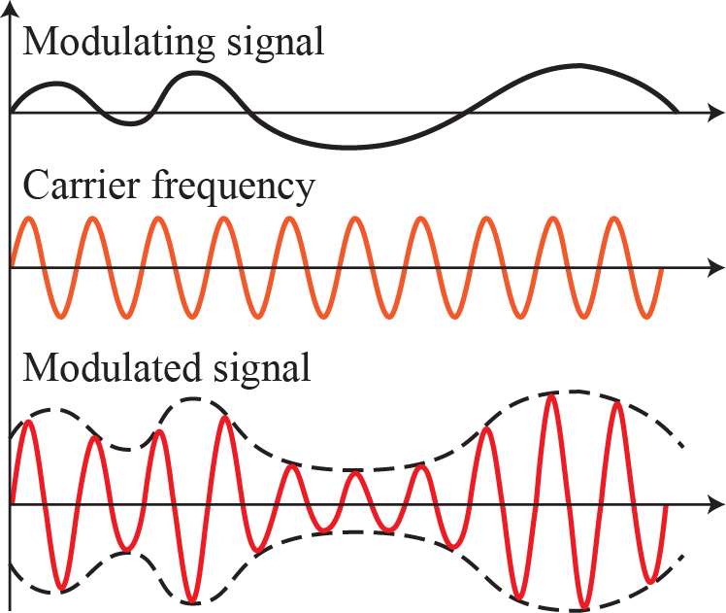
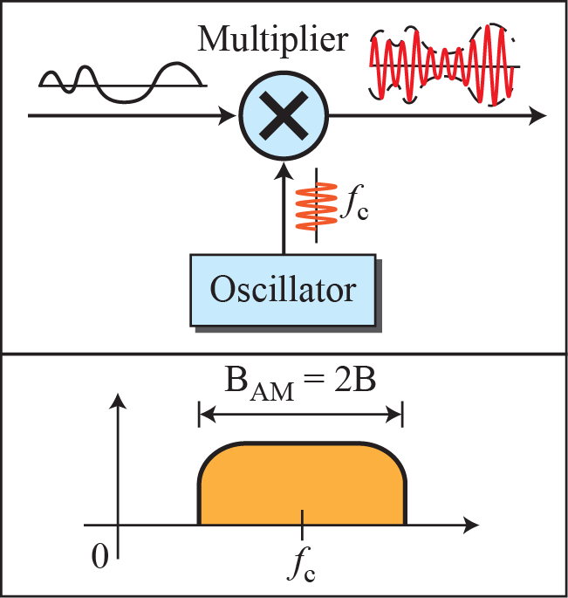
5.2.1 AM(Amplitude Modulation)
AM(Amplitude Modulation)
  The carrier signal is modulated so that its amplitude varies with the changing amplitudes of the modulating signal.
The total bandwidth required for AM can be determined from the bandwidth of the audio signal: B_{AM} = 2B.

Slide 36

5.2.1 AM(Amplitude Modulation)
Bandwidth Allocation for AM Radio
  The bandwidth of an audio signal(speech and music) is usually 5kHz.
  A bandwidth of 10kHz is allocated for an AM radio station.
540
1680
1690
550
560

Slide 37
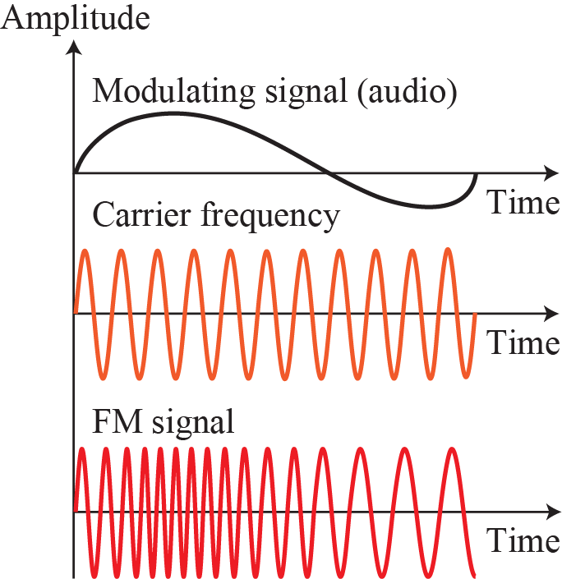
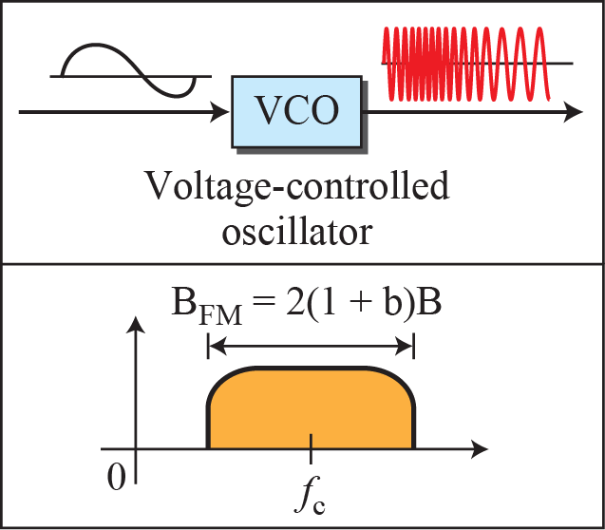
5.2.2 FM(Frequency Modulation)
FM(Frequency Modulation)
  The frequency of the carrier signal is modulated to follow the changing voltage level (amplitude) of the modulating signal.
The total bandwidth required for FM can be determined from the bandwidth of the audio signal: B_{FM} = 2(1 + β)B.
Β is a factor that depends on modulation technique. usually β= 4

Slide 38
5.2.2 FM(Frequency Modulation)
Bandwidth Allocation for FM Radio
  The bandwidth of an audio signal(speech and music) broadcast in stereo is almost 15kHz.
  A bandwidth of 200kHz(0.2MHz) is allocated for each radio station.
88
MHz
88.2
107.6
107.8
108
MHz
200kHz
88.4
88.6

Slide 39
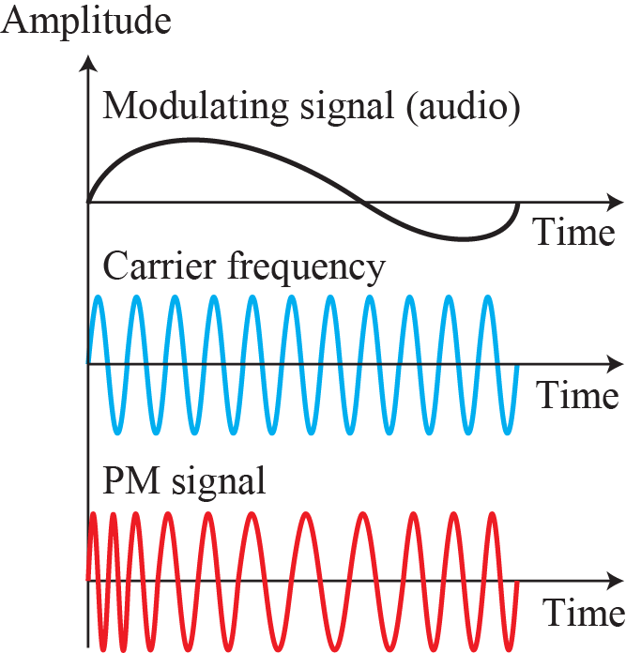
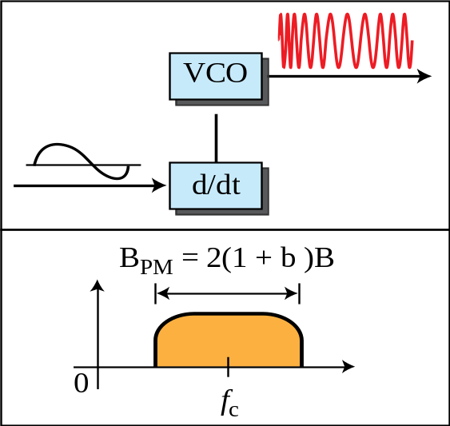
5.2.3 PM(Phase Modulation)
PM(Phase Modulation)
  The phase of the carrier signal is modulated to follow the changing voltage level (amplitude) of the modulating signal.
  The peak amplitude and frequency of the carrier signal remain constant.
  As the amplitude of the information signal changes, the phase of the carrier changes correspondingly.
The total bandwidth required for PM can be determined from the bandwidth and maximum amplitude of the modulating signal: B_{PM} = 2(1 + β)B.
The value of β in PM is lower than FM. Narrowband : 1, wideband : 3

Slide 40

5.3 Summary
Digital-to-Analog Conversion
  Amplitude Shift Keying
  Frequency Shift Keying
  Phase Shift Keying
  Quadrature Amplitude Modulation
Analog-to-Analog Conversion
  Amplitude Modulation
  Frequency Modulation
  Phase Modulation

